Slide 1

INVESTMENT CASE STUDY SUBMISSION
Group Name:
Abhishek Singhal
Hemant Badgujar
Jetendra Mulinti
Prem Kumar R

Slide 2
Abstract
Purpose:
Understand the global trends in investment to take decision effectively.
Process:
Perform analysis on investment type, country & sector to devise a proper strategy for identifying investment opportunities.
Payoff:
Get an appropriate plan to understand where other investors are investing and make decision accordingly to invest between 5 and 15 million USD per round of investment.

Slide 3
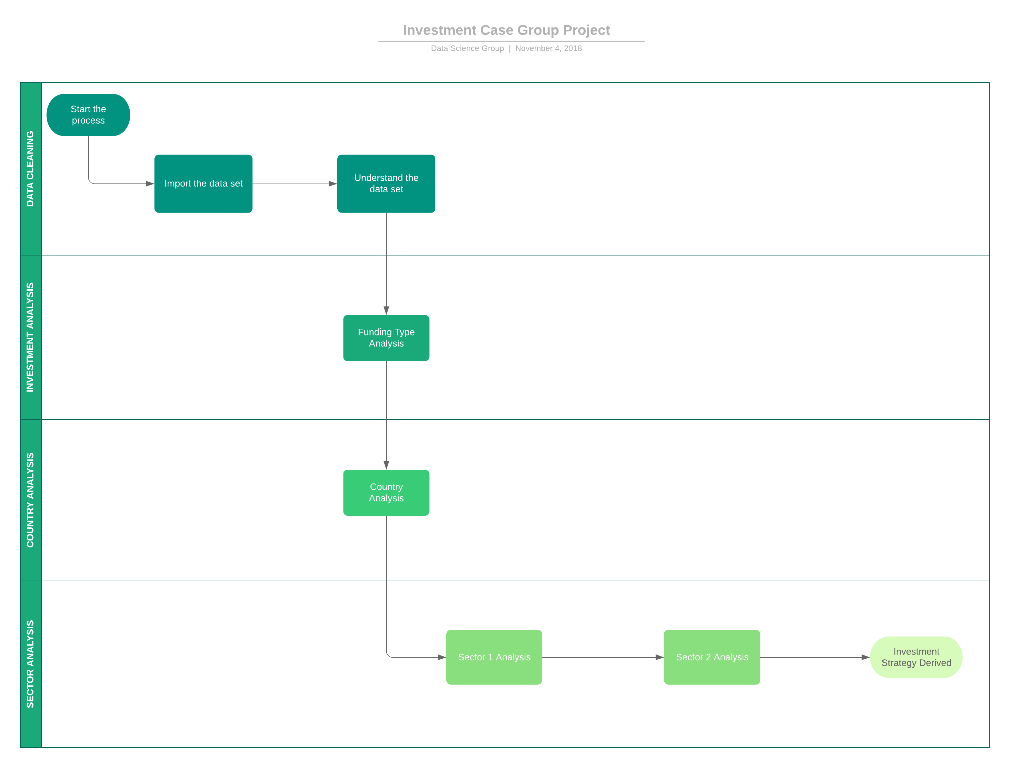
Problem solving methodology

Slide 4
Analysis
Table-1.1
Understand the Data Set
Sl. No | Questions | Answer
1 | How many unique companies are present in rounds2? | 66370
2 | How many unique companies are present in the companies file? | 66368
3 | In the companies data frame, which column can be used as the unique key for each company? Write the name of the column. | permalink
4 | Are there any companies in the rounds2 file which are not present in companies ? Answer Y/N. | Y
5 | Merge the two data frames so that all variables (columns) in the companies frame are added to the rounds2 data frame. Name the merged frame master_frame. How many observations are present in master_frame ? | 114949 rows and 16 columns
Table-2.1
Average Values of Investments for Each of these Funding Types
Sl.No | Questions | Answer
1 | Average funding amount of venture type | $ 1,17,48,949.00
2 | Average funding amount of angel type | $ 9,58,694.00
3 | Average funding amount of seed type | $ 7,19,817.00
4 | Average funding amount of private equity type | $ 7,33,08,593.00
5 | Considering that Spark Funds wants to invest between 5 to 15 million USD per investment round, which investment type is the most suitable for them? | Venture

Slide 5
Analysis
Table - 3.1
Analysing the Top 3 English-Speaking Countries
Sl.No | Questions | Answers
1 | Top English speaking country | USA- United States
2 | Second English speaking country | GBR- Great Britain
3 | Third English speaking country | CAN-Canada
Table - 5.1
Sector-wise Investment Analysis
Sl.no | Questions | C1 | C2 | C3
1 | Total number of Investments (count) | 4901 | 464 | 254
2 | Total amount of investment (USD) | 50937911887 | 4221653357 | 2259674365
3 | Top Sector name (no. of investment-wise) | Others | Others | Others
4 | Second Sector name (no. of investment-wise) | Social, Finance, Analytics, Advertising | Social, Finance, Analytics, Advertising | Social, Finance, Analytics, Advertising
5 | Third Sector name (no. of investment-wise) | Cleantech / Semiconductors | News, Search and Messaging | Cleantech / Semiconductors
6 | Number of investments in top sector (3) | 1277 | 117 | 57
7 | Number of investments in second sector (4) | 856 | 86 | 53
8 | Number of investments in third sector (5) | 775 | 80 | 53
9 | For point 3 (top sector count-wise), which company received the highest investment? | VMTurbo | Lexoo | Anomalous Networks
10 | For point 4 (second best sector count-wise), which company received the highest investment? | A&E Complete Home Services | Puzl | QReserve Inc.

Slide 6
Plot 1 : Total investment Vs Avg. investment of Funding Type

Slide 7
Plot 2 : Top 9 countries vs total amount of investment of Funding type

Slide 8
Plot 3 : No. of investments of top 3 sector vs top 3 countries

Slide 9

Conclusions
The major number of investment & the highest amount of investments are being made in USA.
It is advisable to decide that the following sectors turns out to be top notches of investments “Others, Social, Finance, Analytics, Advertising, Cleantech/Semiconductors”.
Venture funding type can be preferred as the suitable for investment.

